Slide 1
2017-Dec-15
www.nextnano.com
stefan.birner@nextnano.com
How to treat Quaternaries in nextnano
Dr. Stefan Birner, Managing Director
nextnano GmbH, Garching b. München, Germany

Slide 2
Material parameters needed
GaAs/AlGaAs heterostructures (no strain)
effective masses (m_{e}, m_{hh}, m_{lh}, m_{so}, ...) or k∙p parameters
band gap E_{gap}, split-off energy
band offsets (CBO, VBO)
dielectric constant (Poisson equation)

Slide 3
Ternaries
Linear interpolation
Quadratic interpolation using a constant bowing parameter
Interpolation using a bowing parameter which depends on alloy content x

Slide 4
Ternaries
Ternary
Binaries GaAs, AlAs ➔ Ternary Al_{x}Ga_{1-x}As = x AlAs + (1-x) GaAs
Bowing parameter C
– C x (1-x)
– C(x) x (1-x)
might depend on alloy content x

Slide 5
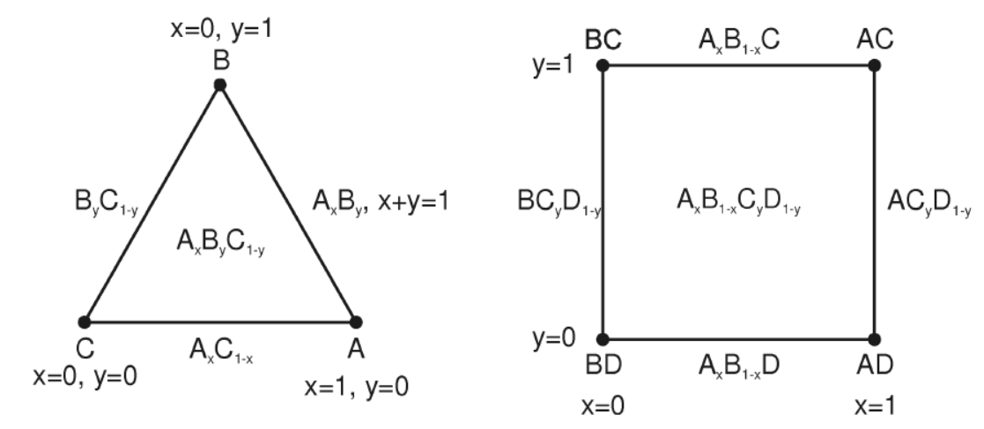
Quaternaries
Quaternary: Al_{x}Ga_{1-x}As_{y}P_{1-y} III-III-V-V
III-III-III-V, III-V-V-V

Slide 6
Quaternaries
Al_{x}Ga_{1-x}In_{1-x-y}As
III-III-III-V
III-V-V-V
10 parameters!

Slide 7
Quaternaries
Al_{x}Ga_{1-x}As_{y}P_{1-y} III-III-V-V
13 parameters!

Slide 8
Material parameters needed
GaAs/InGaAs heterostructures (strain!)
... +
lattice constant
elastic constants (2-3 parameters)
piezoelectric constant
deformation potentials (3-8 parameters)

Slide 9
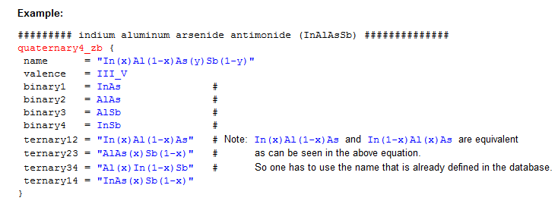
nextnano++ software
http://www.nextnano.com/nextnanoplus/software_documentation/input_file/structure.htm
http://www.nextnano.com/nextnanoplus/software_documentation/database/zincblende.htm

Slide 10
More information
PhD thesis T. Zibold (Appendix E)
http://www.nextnano.com/information/publications.php
nextnano³ software http://www.nextnano.com/nextnano3/input_parser/database/docu/quaternaries.htm http://www.nextnano.com/nextnano3/tutorial/1Dtutorial_AlGaInP_onGaAs.htm

